Slide 1
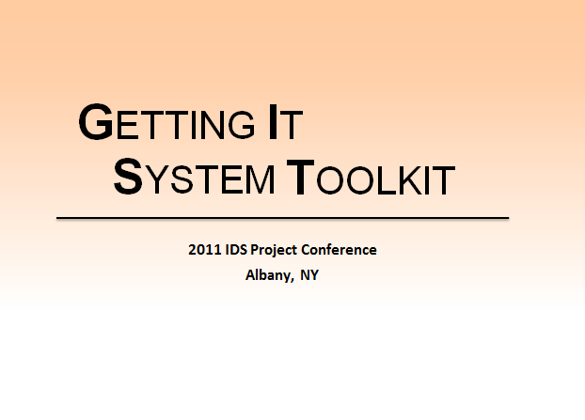

Slide 2
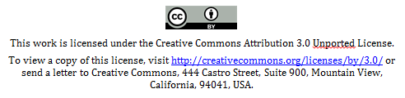
Welcome to the
Getting It System Toolkit
GIST Institute 2011
GIST Team, SUNY Geneseo
Tim Bowersox, bowersox@geneseo.edu
Cyril Oberlander, cyril@geneseo.edu
Kate Pitcher, pitcher@geneseo.edu
Mark Sullivan, sullivm@geneseo.edu

Slide 3
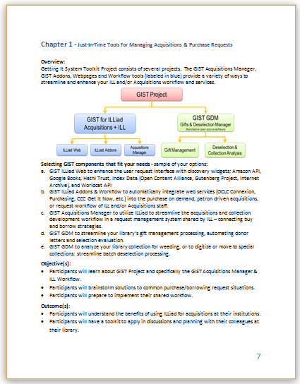
GIST Institute
All presentations and color handouts will be made available from the GIST website: http://gettingitsystemtoolkit.wordpress.com/
GIST Institute objectives
Focus on learning about GIST,
sharing ideas about service design
and innovations that improve workflow.
Provide attendees with an immersive experience and activities designed to help implementing GIST components.
GIST Institute Workbook

Slide 4
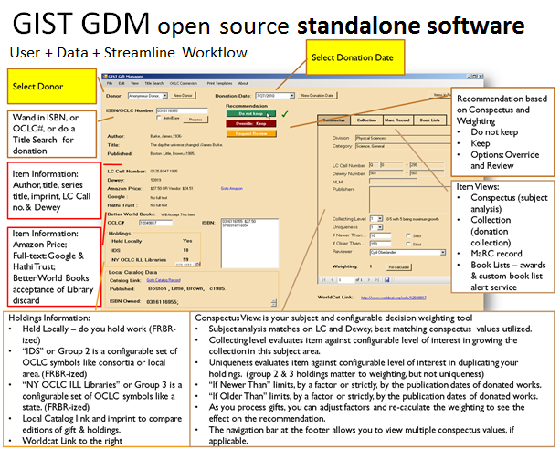
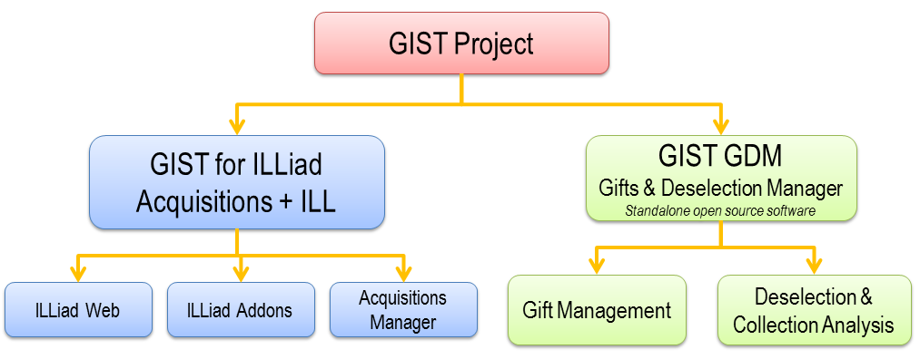
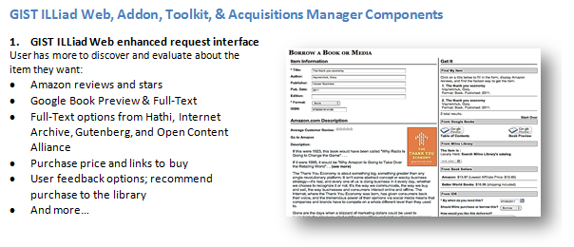
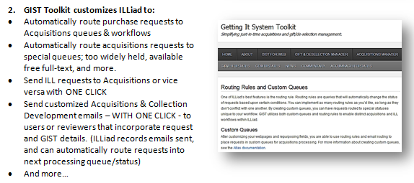
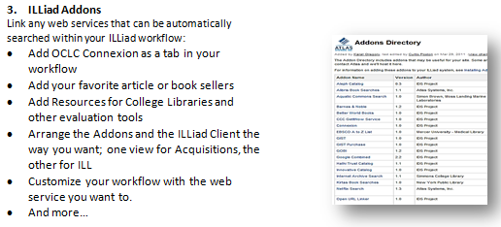
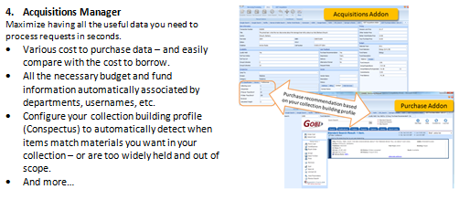
GIST Overview

Slide 5
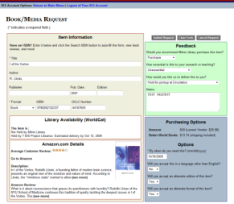
GIST Request
Interlibrary Loan
Cancel or Unfilled
Filled
Borrow
Acquisitions
Filled
Buy
Cancel or Borrow
Requests are Transferable
Will ILL and Acquisitions converge?
Count on a strategic partnership rapidly evolving.
What role do you have in it?

Slide 6
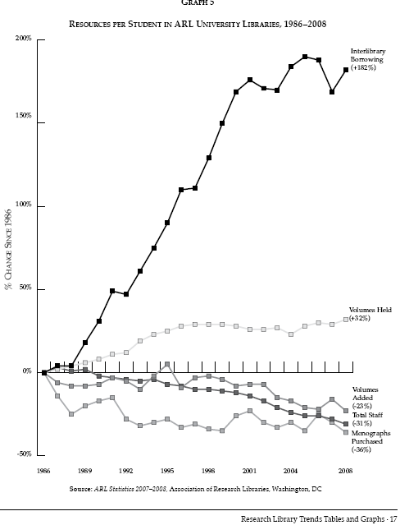
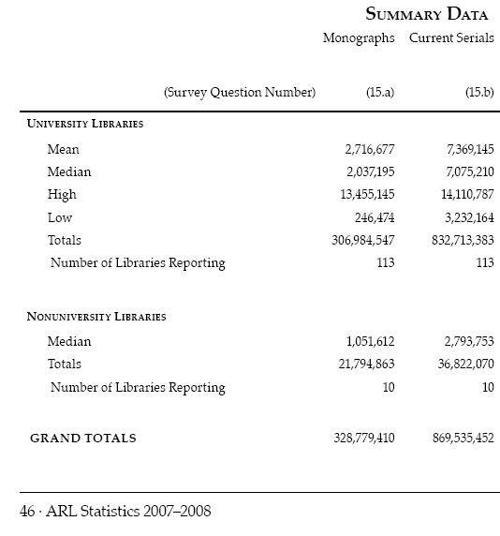
Monograph Spending & ILL
2009 over 11 Million ILL requests (ALA)
Association of Research Libraries 2007-2008
Notes:
http://www.arl.org/bm~doc/arlstat08.pdf p. 46, 17

Slide 7
It’s the Economy…
April 6, 2008 a day in the life of ILL…
110 borrowing requests for loans came into SUNY Geneseo, of these…
79.1% or 87 items could be purchase from Amazon; about 46% could be purchased for under the ARL unit cost for borrowing: $17.50
Over 1/3 could be purchased for less than $10 used
(almost 1/5 for less than $5)
Over 1/5 could be purchased new for less than $10.
Price of lending charges is often higher than the price to buy.
Massive weeding of libraries is exponentially increasing the availability and reducing prices of buying.
Print on Demand industry enables purchasing in lieu of problematic ILL of medium-rare books / purchase price is comparable to lending charges.
Libraries increasing their lending charges are more reliant on revenue that is going away.
“retrospective buying projects are feasible… and for monographs, purchase may be a reasonable substitute for interlibrary loan.” Holley & Ankem, 2005

Slide 8



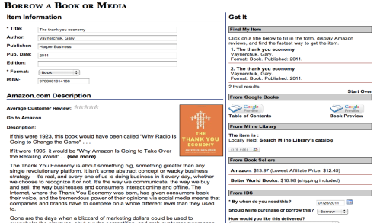
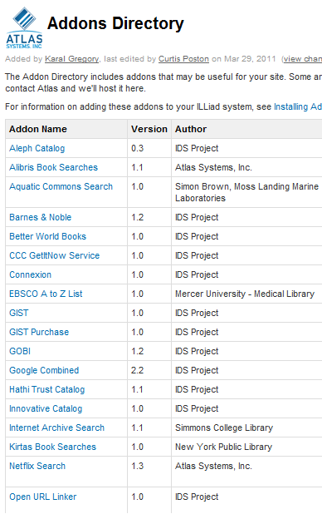
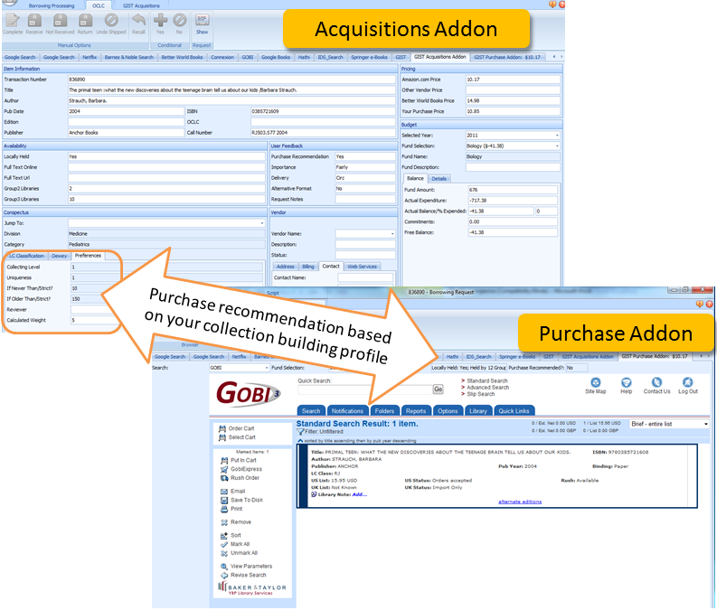
GIST Acquisitions Manager Overview: assembling the pieces…
GIST Toolkit
Service Delivery

Slide 9
Activity A: Shared Benefits
If a patron request is…
Too new to borrow
Then you would…
Not held in state and costs $25 to borrow or $45 to buy
Then you would…
… and for monographs, purchase may be a reasonable substitute for interlibrary loan.” Holley & Ankem, 2005
Notes:
http://www.arl.org/bm~doc/arlstat08.pdf p. 46, 17

Slide 10
GIST for Web – Enhancements
GIST Acquisitions Manager

Slide 11
What is GIST for Web?
Enhancements to the ILLiad webpages
  Provide item information from Amazon.com
  Display full text from Google Books, Hathi, Internet Archive, and Project Gutenberg
  Display local holdings or estimated ILL delivery
  List vendor prices for personal copies
See Chapter 2 in workbook.

Slide 12
How does it help?
Enhances your ILL
Facilitates Purchase on Demand
Directs users to “self-serve” options first
Built-in discovery tool increases request accuracy
  Title & author keywords
  ISBN
Automatically detects locally held materials
Users can evaluate each item before requesting
Provides price & holdings data to staff in ILLiad
Functionality can be limited to certain types of users
  Faculty?
  Librarians?
  Everyone?

Slide 13
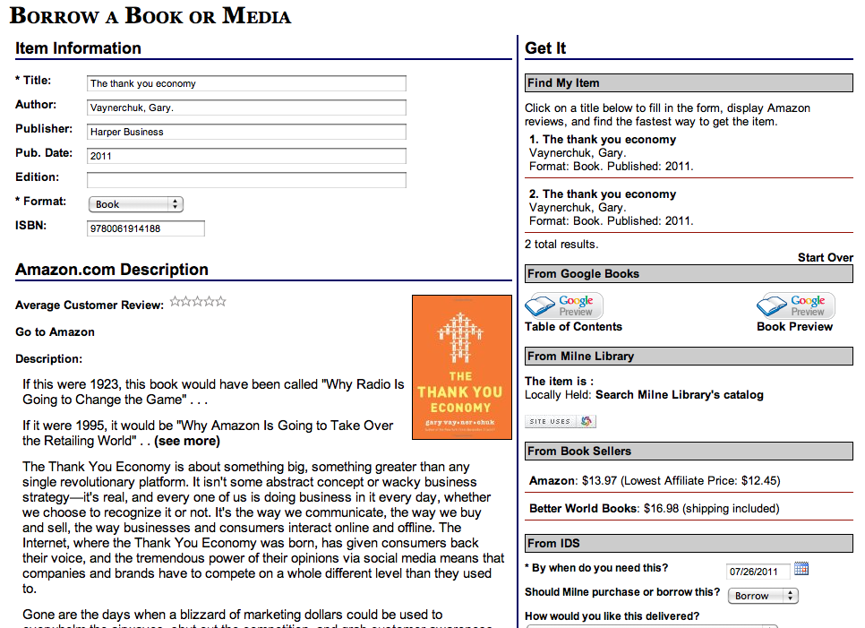
Notes:
This is how the GIST-enhanced request form looks at Geneseo.

Slide 14
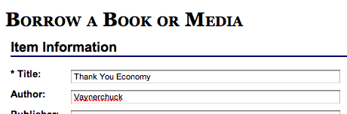
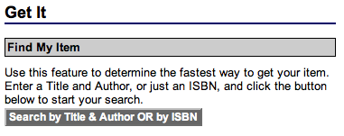
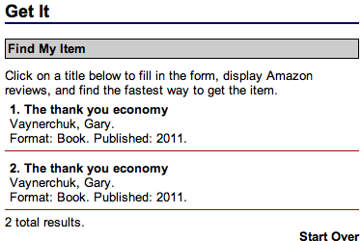
Find My Item
Built-in discovery tool to help users request the right item.
Two ways to search:
  Title & author
  ISBN
Once user finds the item, the web enhancements will run.
This will also fill in the entire item citation.
Notes:
This expands upon the first versions simple ISBN search to include Title/Author keyword searching.
For ILL, this increases the odds that Direct Request can be utilized.
For Acquisitions, this helps users browse formats and editions.
For both, this helps users discover the “right” item if they didn’t come via OpenURL from a database or catalog.

Slide 15
Amazon
If the item is listed on Amazon.com, users will see a description, average customer review, and a cover image.
Users can even click to view the entire page on Amazon.com.
Notes:
Regardless of request type, this helps users decide whether or not they really want the item.

Slide 16

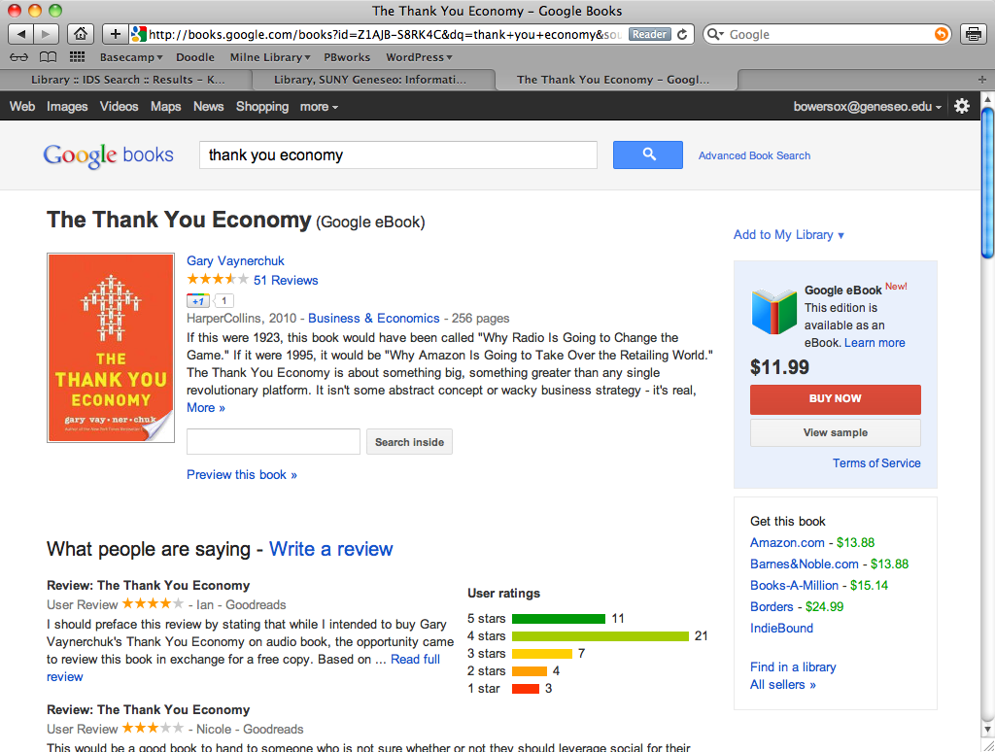
Google Books
If available, this connects users to the Table of Contents and Book Preview or Full View in Google Books.
Notes:
For many new books, users can view the Table of Contents and Book Preview. Otherwise, they can quickly access the full text.
The best part is that this allows users to search the book in full text to see if it’s relevant.

Slide 17
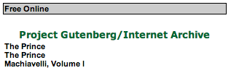



Index Data
This connects users to any free full text or audio books from the Hathi Trust, Project Gutenberg, or the Internet Archive.
Notes:
This helps connect users to the otherwise hidden resources from Project Gutenberg and the Internet Archive (they are not indexed by Google).

Slide 18
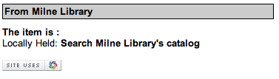
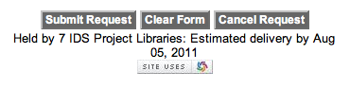
WorldCat
If locally held…
Helps users discover locally held items before placing a request.
If the item is held locally, they are a click away from your catalog.
Otherwise, it provides a customized ILL delivery estimate based on group holdings.
…otherwise
Notes:
This can be customized—you choose two groups of OCLC symbols:
Group 2: what about your library consortia?
Group 3: expand this—what about the entire state?
For each you can specify how many days an average delivery could take. Then you can specify how long it would take if no groups own it.

Slide 19
Vendor Prices
This allows users to see how much their item costs from major book sellers.
This can help them evaluate whether to purchase their own copy or if it’s worth having the funds deducted from their department allocation.
Currently, only Amazon and Better World Books are listed. More vendors will be available as we obtain APIs.
Notes:
As more vendors join the fun, we can use their APIs to provide a larger, customized listing.
In relation to the Acquisitions Manager, this can help your faculty and librarian users determine if the price is right.
For everyone, they may discover that a book is so cheap they’ll just buy their own copy.
Consider adding a link for donations in case the user only needs the item for a little while.

Slide 20
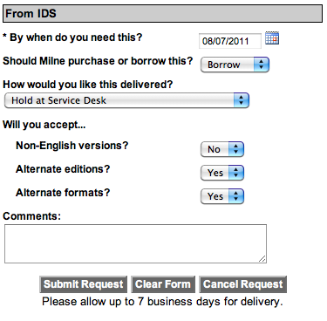
User feedback
Users can indicate their preferences to aid staff in making informed decisions.
“Needed by” date
Importance (hidden)
Purchase recommendation
Delivery preference
Alternate format or edition
Comments
Notes:
Most of this is default ILLiad data; however, the Purchase/Borrow question can be customized—so too can the delivery options.
Importance is hidden here because we did not utilize it for this user status in this example.
Note that for each user status in ILLiad you can create a custom request form. You can change questions, hide widgets, and disable purchasing.

Slide 21
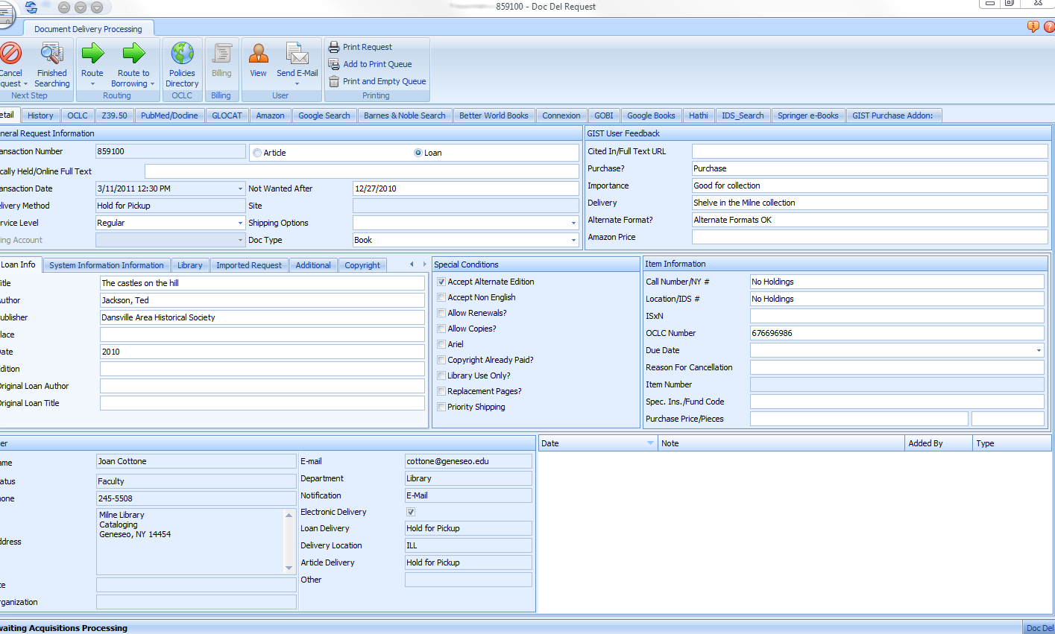
Staff see feedback & data…
Data
Request form
ILLiad client
…for making informed decisions
Notes:
Behind the scenes, GIST gathers a lot of the data that the user sees and sends it along with their feedback and item info into the ILLiad client.
Staff can then view all of the info in one convenient place to make informed decisions.

Slide 22
Getting Started
(See Follow-Up on p.16)
Get your API keys from Amazon & WorldCat
Download the GIST.zip file at:
  http://gist.idsproject.org
Unzip and configure on ILLiad server
Create tester status & webpages
Embed the code & give it a try!
Notes:
Remind everyone that the best results happen when the right people work together:
ILL head
Webmaster
Acquisitions head
Administration
Note that this now uses dedicated database tables in ILLiad—if upgrading, be sure to use the specified fields in the documentation (coming soon).

Slide 23
Questions?
GIST for Web

Slide 24
GIST Addons for ILLiad
GIST Acquisitions Manager

Slide 25
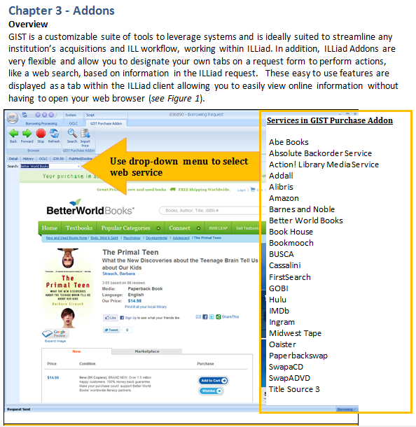
Purchasing Addon
How it works…
Open request in ILLiad.
Purchasing Addon automatically searches your default vendor for that item; with over 20 other vendors on the drop down.
See Chapter 3 in workbook.

Slide 26
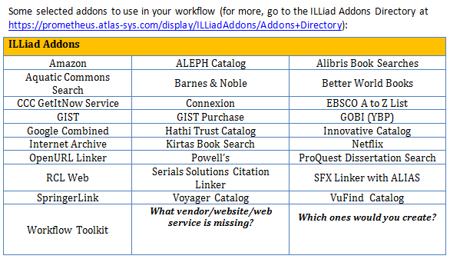
Selecting or Creating your Addon for your workflow

Slide 27
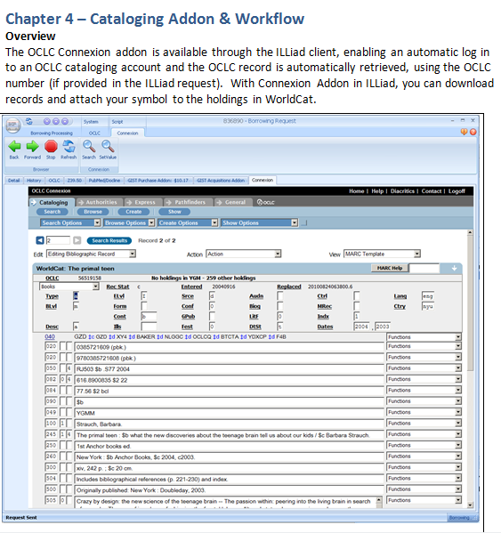
Example: Cataloging Addon & Workflow
Adding an automated search into OCLC Connexion is easy…
You decide where in the process it fits;
You decide who uses this addon;
You decide how to fit the cataloging process into GIST & ILLiad.

Slide 28
Now putting the pieces together in
GIST Acquisitions Manager
GIST Toolkit
Service Delivery

Slide 29
Budget & Funds in the Acquisitions Manager
GIST Acquisitions Manager

Slide 30
GIST ILLiad Tables Schematic
GIST Vendor
GIST History
GIST Invoice
GIST Web
Transactions
GIST Funds
GIST Conspectus
Users
GIST Fund Link
Notes:
Click 1: GISTWeb
User feedback
Purchase recommendation
Full text flag & URL
Local Holdings flag
Click 2: GISTFundLink
Connects users to funds
One user can belong to multiple funds
Click 3: GISTFunds
Allocate budgets
Set by department or user
A query adjusts balances
Click 4: GISTHistory
Connects the tables
Lets you review the history of purchase transactions
Click 5: GISTInvoice
Record your individual orders
Transaction detail
Click 6: GISTVendor
Track your vendor info like the Lender Addresses table
Stores your local discounts and sales rep contact info
Click 7: GISTConspectus
Set your collection building priorities
By subject area, publication date, and holdings

Slide 31
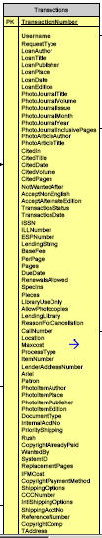
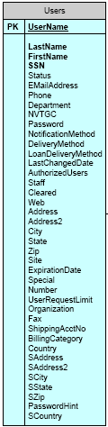
GIST ILLiad Tables
ILLiad Transactions Table
GISTFundLink
ID
UserName
GISTFundsID
GISTVendorID
PrimaryReviewer
SecondaryReviewer
UsersStatus
Department
GISTVendor
ID
Description
VendorName
ShippingAddress
BillingAddress
Phone
Fax
Website
ContactName
Position
ContactPhone
ContactFax
ContactEmail
BillingMethods
Status
APIKeyPrimary
APIKeySecondary
WebServiceUsername
WebServicePassword
DiscountNotes
PercentDiscount
EstimatedTax
NotesForOrdering
VendorNotes
GISTHistory
ID
TransactionNumber
GISTFundsID
ApprovedBy
GISTVendorID
GISTInvoice
ID
VendorID
VendorInvoice
TransactionNumber
FinalPrice
Tax
Shipping
FundBudgetSource
PurchaseOrder
PaymentMethod
DateOrdered
DeliveryDate
DateReceived
DatePaid
DateClaimed
Notes
NumCopiesOrdered
ILLiad Users
Table
GISTFunds
ID
FundName
FundAmount
ActualExpenditure
ActualBalance
Commitments
FreeBalance
PercentExpended
FundYear
Active
FundBudgetSource
UserName
AssociatedDept
AssociatedFunds
FundDescription
FundRestrictions
Notes
StartDate
EndDate
ToggleFreeActual
Other
GISTWeb
ID
TransactionNumber
AmazonPrice
BetterWorldBooksPrice
OtherPrice
LocallyHeld
FullTextOnline
FullTextURL
PurchaseRecommendation
Importance
Delivery
AlternativeFormat
PurchasePrice
Group2Libraries
Group3Libraries
GISTConspectus
ID
Division
Category
LCCategory
LCNum
LCNumRange
Dewey
DeweyRange
NLM
Publishers
CollectingLevel
Uniqueness
IfNewerThan
NewerStrict
IfOlderThan
OlderStrict
LibReviewer

Slide 32
GIST ILLiad Tables Schematic
GISTVendor
Track your vendor info like the Lender Addresses table
Stores your local discounts and sales reps
GISTHistory
Connects the tables
Lets you review the history of purchase transactions
GISTInvoice
Record your individual orders
Transaction detail
GISTWeb
User feedback
Purchase recommendation
Full text flag & URL
Local holdings flag
GIST Vendor
GIST History
GIST Invoice
GISTFunds
Allocate budgets
Set by department or user
Query adjusts balances
GIST Web
Transactions
GIST Funds
GISTFundLink
Connects users to funds
One user can belong to multiple funds
GISTConspectus
Set your collection building priorities
By subject area, date, and holdings
Users
GIST Fund Link
GIST Conspectus
Notes:
Click 1: GISTWeb
User feedback
Purchase recommendation
Full text flag & URL
Local Holdings flag
Click 2: GISTFundLink
Connects users to funds
One user can belong to multiple funds
Click 3: GISTFunds
Allocate budgets
Set by department or user
A query adjusts balances
Click 4: GISTHistory
Connects the tables
Lets you review the history of purchase transactions
Click 5: GISTInvoice
Record your individual orders
Transaction detail
Click 6: GISTVendor
Track your vendor info like the Lender Addresses table
Stores your local discounts and sales rep contact info
Click 7: GISTConspectus
Set your collection building priorities
By subject area, publication date, and holdings

Slide 33
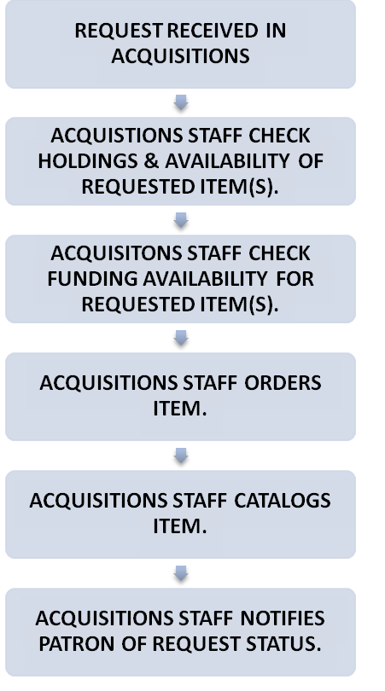
Acquisitions Workflow
GIST
GIST
GIST
Notes:
Acquisitions workflow when processing a purchase request…
Request received. CLICK
Staff check holdings & vendor availability of item.
Staff check funding availability for requested item.
Order item. CLICK
Catalog item. CLICK
Receive item and notify patron.
Many of these steps are now streamlined through GIST and ILLiad. CLICK -- However, workflow is often interrupted at the point of checking for budget and funding due to the inaccessibility of this information, usually kept in an ILS or a separate spreadsheet somewhere on your computer.
This is where the GIST Acquisitions Manager comes in…

Slide 34
Activity
What steps do you take when expending money from a budget?
Step 1
Step 2
Step 3
Step 4
Step 5
In each step of the process,
what sources and important data are you capturing?
See Chapter 5 in workbook.
Notes:
Page __ of workbook

Slide 35
GIST Acquisitions Manager
Top-level addon in main client window
Manage your GIST table data
  Budget: manage your funding allocations
    User-specific funds
    Department-specific funds
  Vendors: manage vendor details in one place
  Conspectus: identify areas of collection growth
    Weight subject areas to inform purchasing decisions
    Specify favored publishers
Notes:
User interface for:
Creating budgets
Tracking funds
Editing vendor information
Customizing your collection-building profile

Slide 36
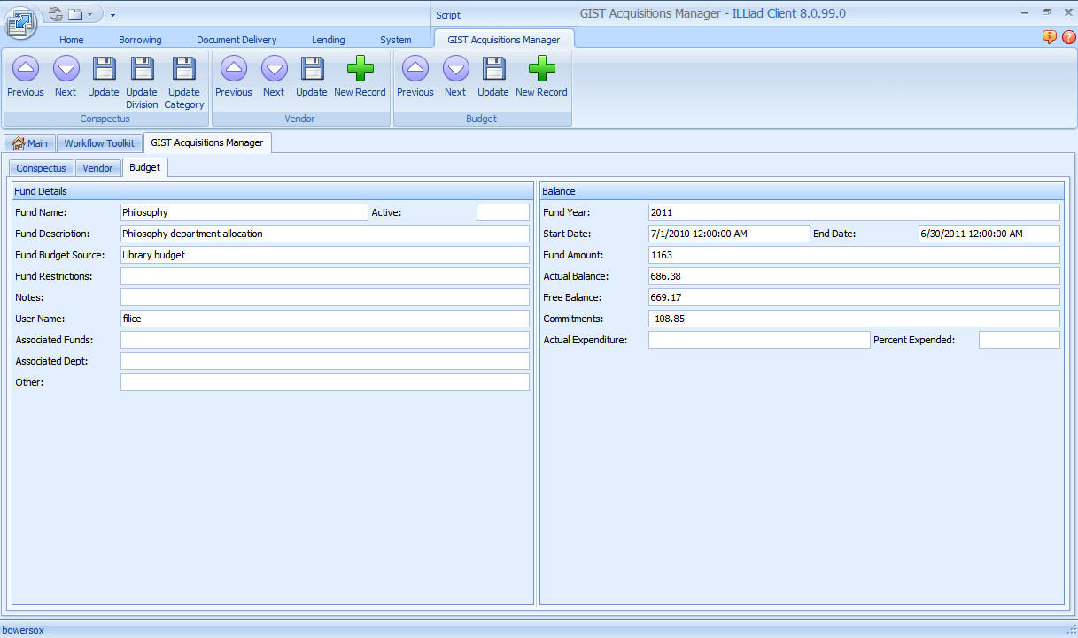
Budget:
Fund name
Username(s)
Actual balance
Encumbrances
Current year info
Associated funds info
Notes:
Use the Budget tab to:
Create funds and associate usernames with funds
Because the GIST Acq Manager is the editor for managing the GIST Table data, this is the interface for managing the real-time data which will inform your acquisitions or ILL workflow

Slide 37
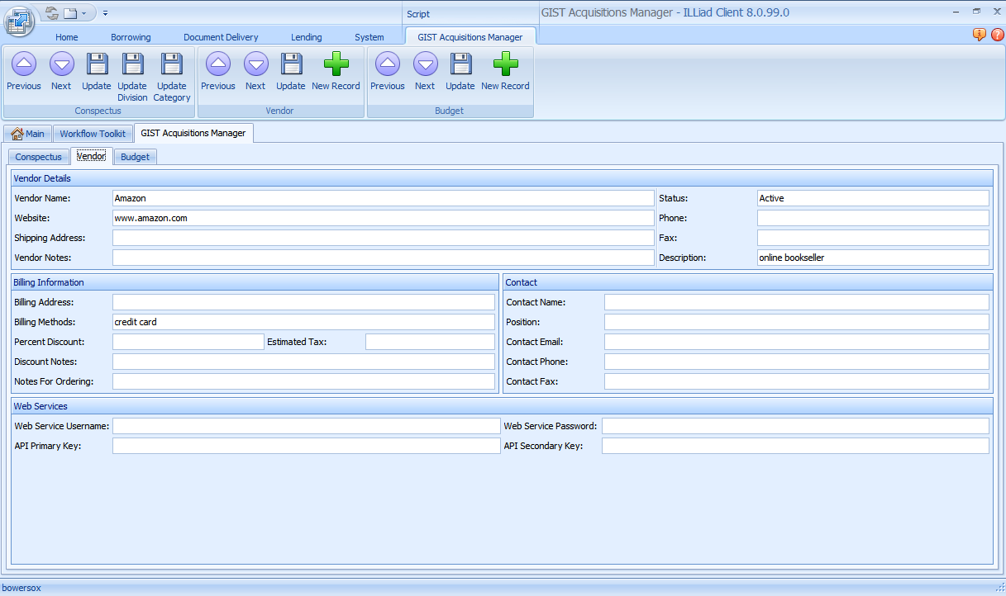
Vendor:
Contact information
API keys
Store username and passwords
Billing and purchasing methods
Notes:
Vendor tab
Utilize the GIST Acquisitions Manager for keeping track of vendor contact information, billing information and the different web services associated with particular vendors
Think of it like ILL’s Lender Addresses Table, but for Acquisitions!

Slide 38
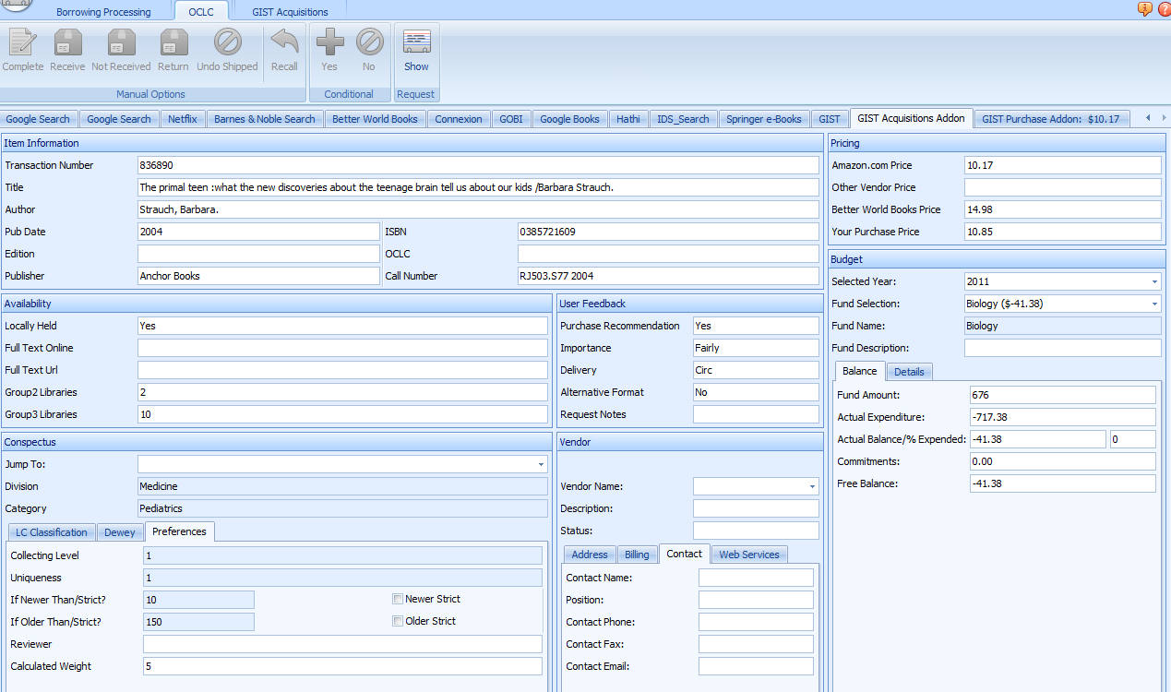
GIST Acquisitions Manager
Budget & Funds all appear in context to request; status, username, etc.
Request pulls in from GIST Tables…
  Fund information
  - actual balance
  - expenditure amount
  - remaining balance
  Other funds available
  Conspectus weight
  - brings in call number
Notes:
So where does all this info go?
The GIST Tables data is pulled into the actual order/request when queried

Slide 39
Item Information
Standard request details from Detail Tab
Call number filled in from GIST Web API
Pricing Information
Default values from Amazon and Better World Books
Has place for actual purchase price
Availability
Locally held?
Full text?
Consortial holdings
User Feedback
User data from GIST Web pages
Budget
Fund loaded based on Status and Department of user
Secondary library fund also available
Updates Commitments and Expenditures
Displays money left in account
Vendor Information
Data from the GISTVendor Table
Allows quick access to vendor data for contact and billing
Conspectus
Collection building data
Weighting included consortial holdings calculations

Slide 40
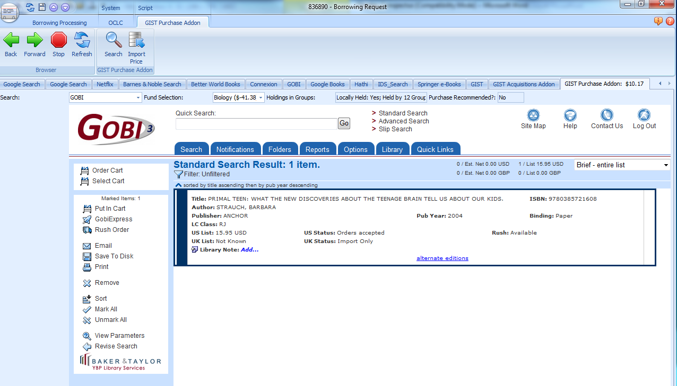
GIST Acquisitions Manager: Conspectus
Acquisitions Addon
Your automated customizable collection building profile for Acquisitions & ILL
Purchase recommendation based on your collection building profile
Purchase Addon

Slide 41
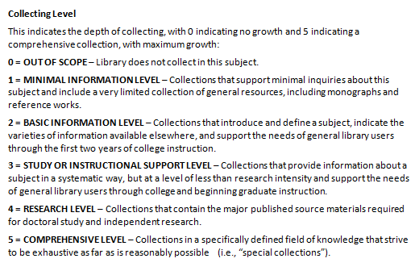
Conspectus
Customizing your Conspectus
The OCLC Conspectus is a subject hierarchy consisting of divisions, categories, and subjects. The conspectus provides a framework to describe library collections, and is mapped to Dewey Decimal, Library of Congress and National Library of Medicine classification schemes. The conspectus is structured in hierarchical order, from broad divisions to very specific subjects and each level is increasingly more detailed.
GIST makes the Conspectus automatically useful and customizable to your workflow.
Libraries may select areas of the conspectus to correspond with areas to grow the collection, or subject areas that are out of scope.
Making these decisions ahead of time or as you use GIST by customizing the conspectus to your collection building profile automates much of the evaluation process.

Slide 42


GIST Acquisitions Manager: Conspectus
Factors besides collecting levels Conspectus
You already have the title.
  Your OCLC symbol(s) and set Uniqueness to indicate willingness to duplicate.
Number of holding libraries in Group 2 & 3
  You list your libraries in your groups or state.
Publication Dates
  You configure desirable publication dates within 1,590+ subjects
LC and Dewey Subject Classification
Additional Features:
Subject Reviewer/Selector automatically matched to request.
See Chapter 6 in workbook.

Slide 43
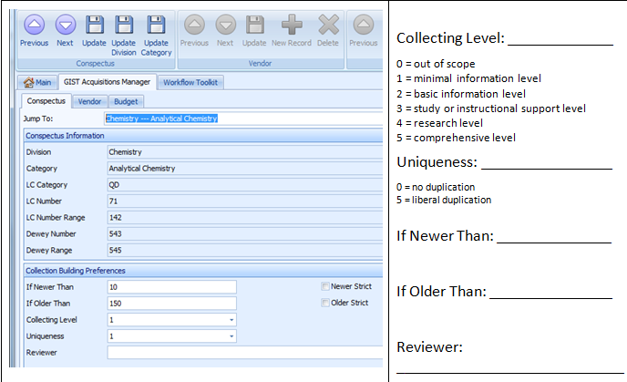
GIST Conspectus Practice I
See Chapter 6 in workbook.

Slide 44
Installation and configuration
GIST Gift and Deselection Manager

Slide 45
GIST GDM
Standalone system that is intended to automate and streamline Gifts and Weeding
  Data from your catalog, Amazon, WorldCat
  Local Holdings, and 2 configurable groups
  Has Better World Books desirability added
  Allows you to select donor if gift processing – with anonymous set as default
  Generates acknowledgement letters as needed.
  Has a complete Conspectus which can be adjusted.
  Has additional Book Lists, such as Newbery and Caldacot

Slide 46
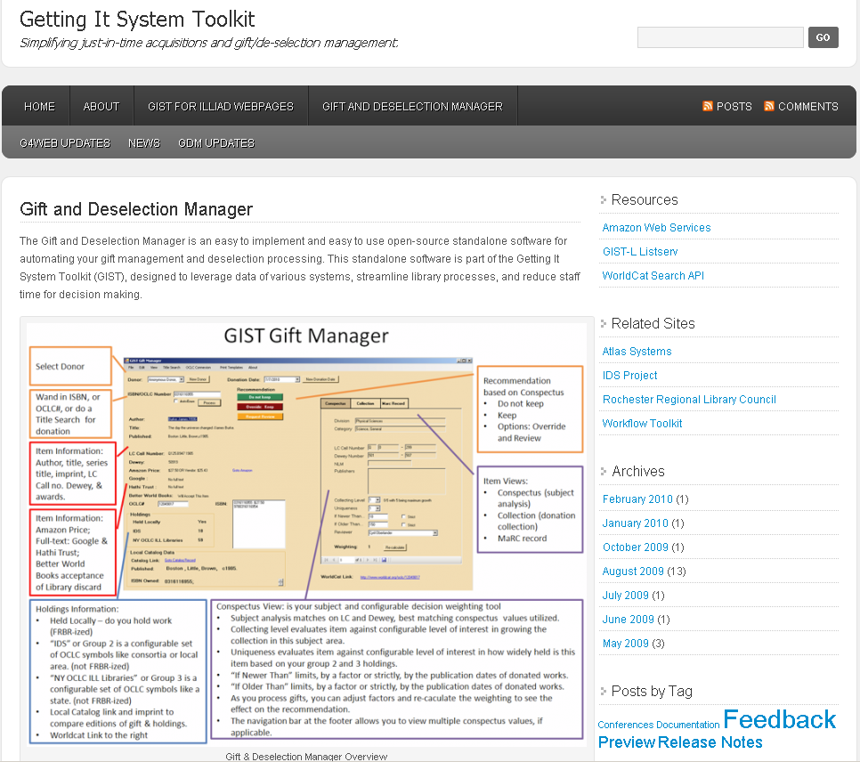
http://gist.idsproject.org

Slide 47
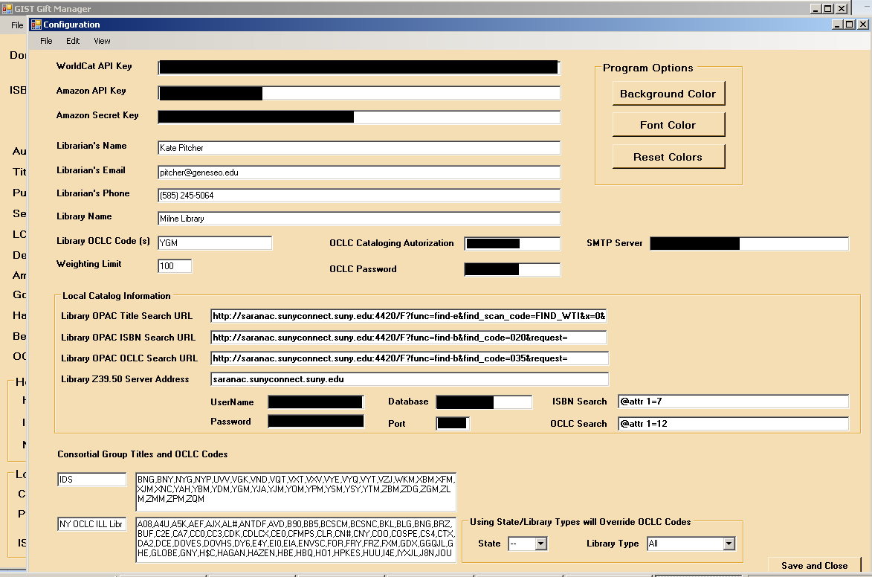
Setup
Notes:
First time you log in, you will be brought to the configuration screen.

Slide 48
Activity A
Activity A: Consider the following table of criteria. Which ones matter when determining whether to keep a gift? Why?
Holdings | Collection Profile
Local & Format duplication | LC or Dewey areas in scope
Consortia (e.g. held by more than 3 libraries) | LC or Dewey areas out of scope
Region or State | Publication Dates (newer than, older than)
Full Text (e.g. held free full-text by Hathi) | Publisher
Other? | Other?
Other? | Other?
See Chapter 7 in workbook.

Slide 49
Gift Management and Evaluation Using GDM
GIST Gift and Deselection Manager

Slide 50
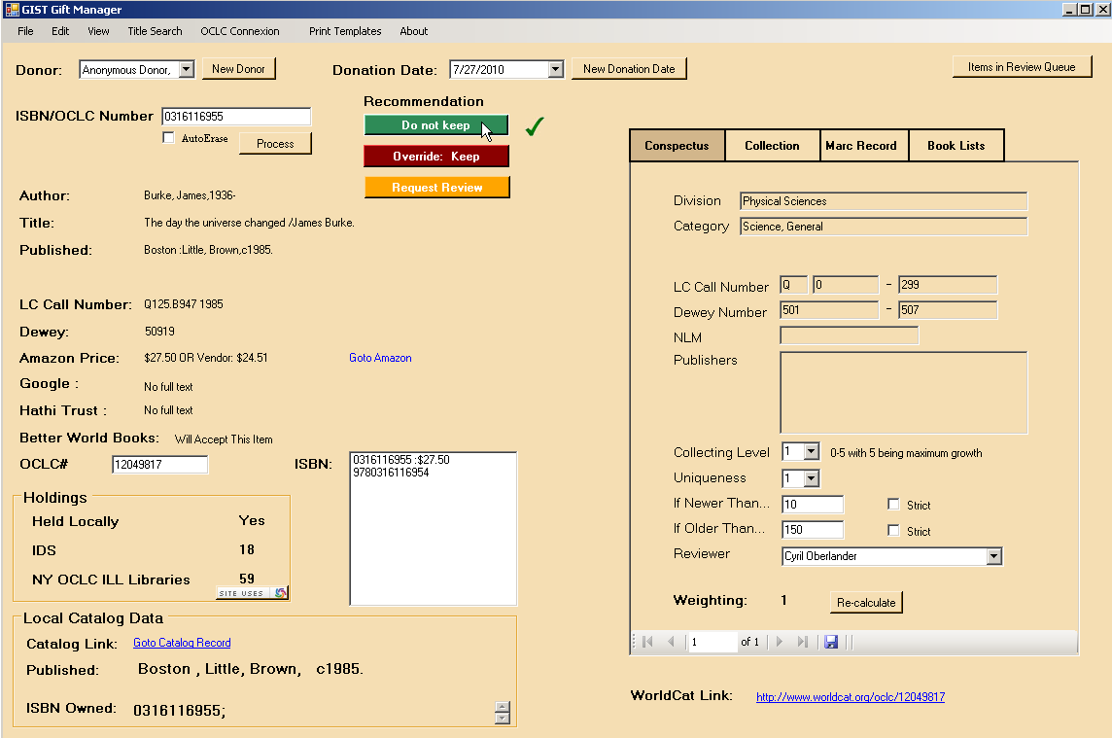
GIST Gift Manager
Select Donation Date
Select Donor
Recommendation based on Conspectus and Weighting
Do not keep
Keep
Options: Override and Review
Wand in ISBN, or OCLC#, or do a Title Search for donation
Item Information:
Author, title, series title, imprint, LC Call no. & Dewey
Item Views:
Conspectus (subject analysis)
Collection (donation collection)
MaRC record
Book Lists – awards & custom book list alert service
Item Information:
Amazon Price;
Full-text: Google & Hathi Trust;
Better World Books acceptance of Library discard
Holdings Information:
Held Locally – do you hold work (FRBR-ized)
“IDS” or Group 2 is a configurable set of OCLC symbols like consortia or local area. (not FRBR-ized)
“NY OCLC ILL Libraries” or Group 3 is a configurable set of OCLC symbols like a state. (not FRBR-ized)
Local Catalog link and imprint to compare editions of gift & holdings.
Worldcat Link to the right
Conspectus View: is your subject and configurable decision weighting tool
Subject analysis matches on LC and Dewey, best matching conspectus values utilized.
Collecting level evaluates item against configurable level of interest in growing the collection in this subject area.
Uniqueness evaluates item against configurable level of interest in how widely held is this item based on your group 2 and 3 holdings.
“If Newer Than” limits, by a factor or strictly, by the publication dates of donated works.
“If Older Than” limits, by a factor or strictly, by the publication dates of donated works.
As you process gifts, you can adjust factors and re-caculate the weighting to see the effect on the recommendation.
The navigation bar at the footer allows you to view multiple conspectus values, if applicable.
Notes:
0316116955
Conspectus: www.oclc.org/collectionanalysis/support/conspectus.xls

Slide 51
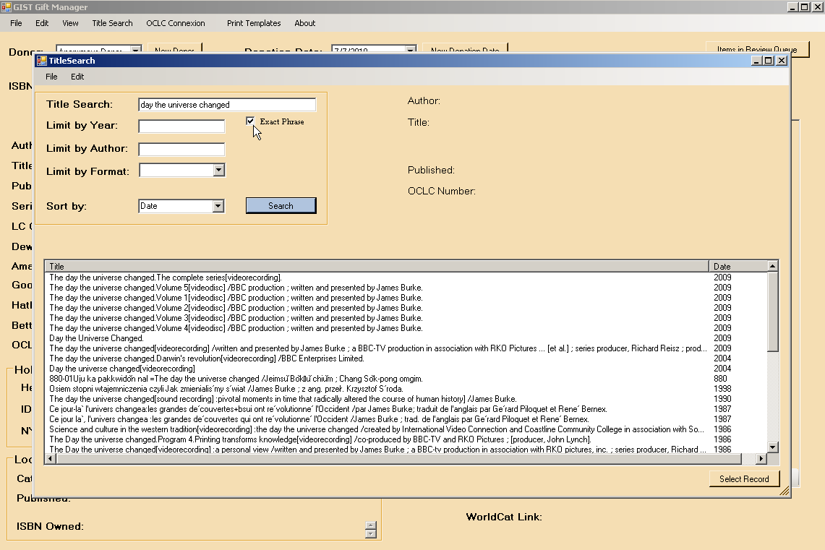
Title Search

Slide 52
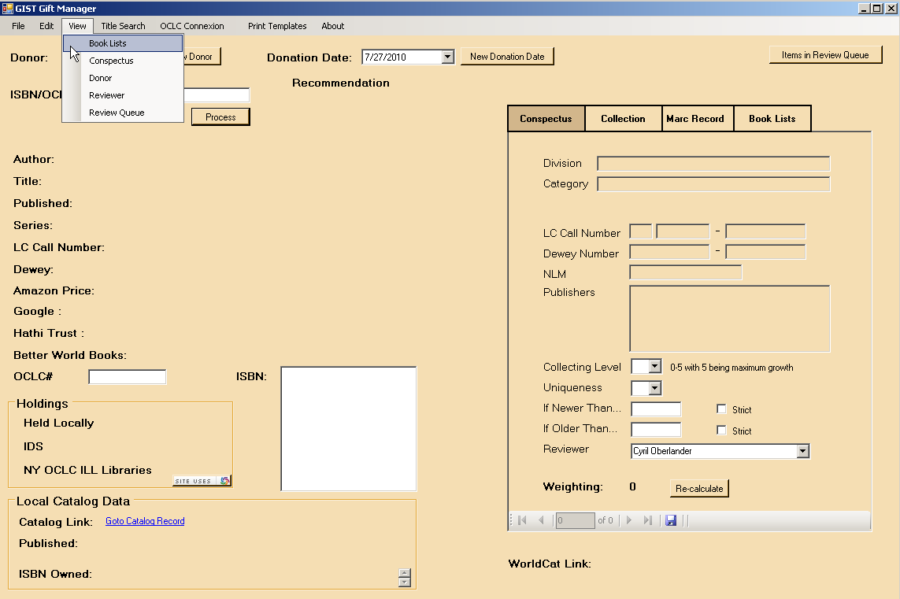
View

Slide 53
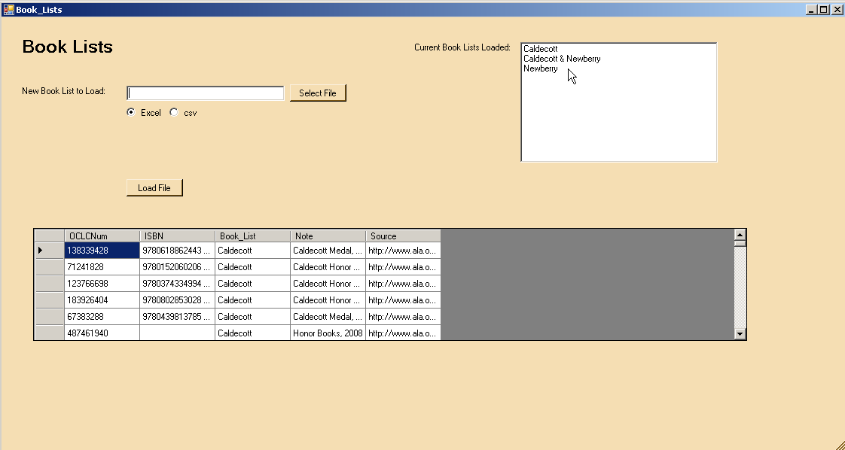
Book Lists

Slide 54
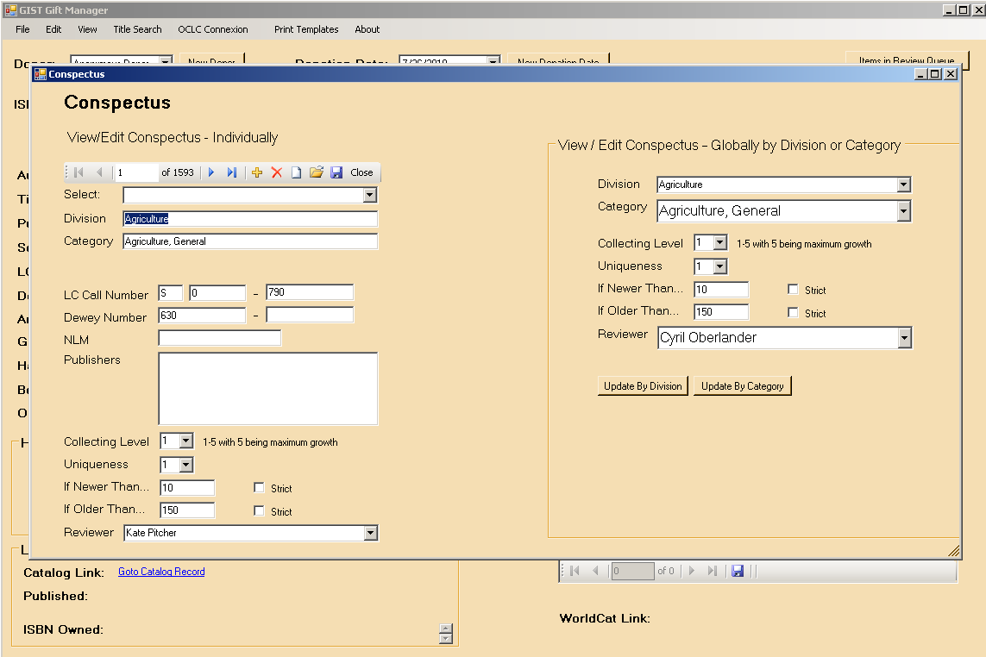
Conspectus

Slide 55
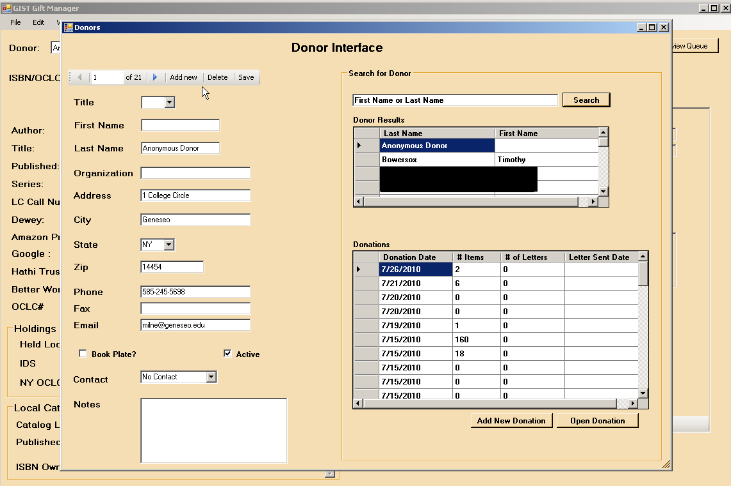
Donor

Slide 56
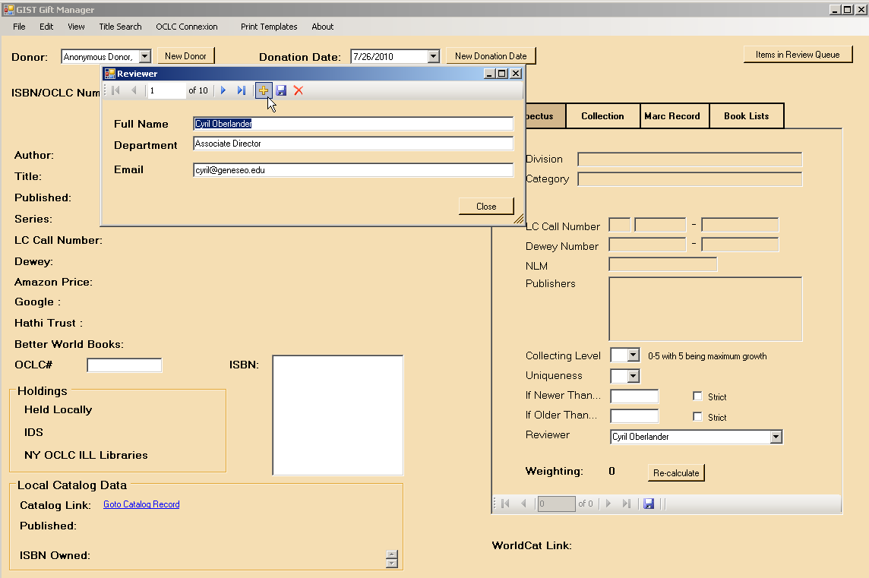
Reviewer

Slide 57
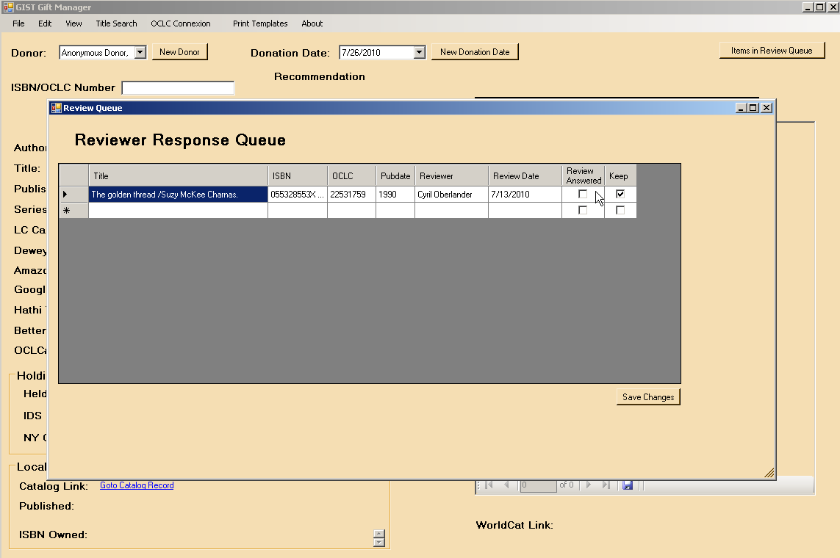
Reviewer Queue

Slide 58
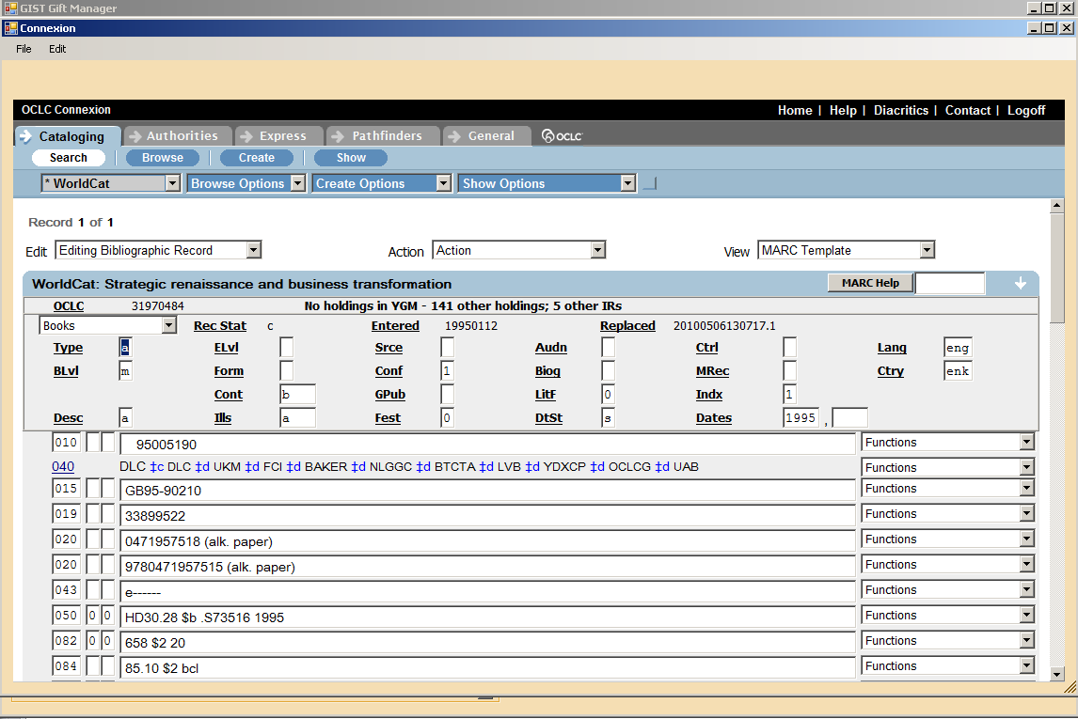
OCLC Connexion
Notes:
Need shot with keeper Strategic renaissance… oclc 31970484

Slide 59
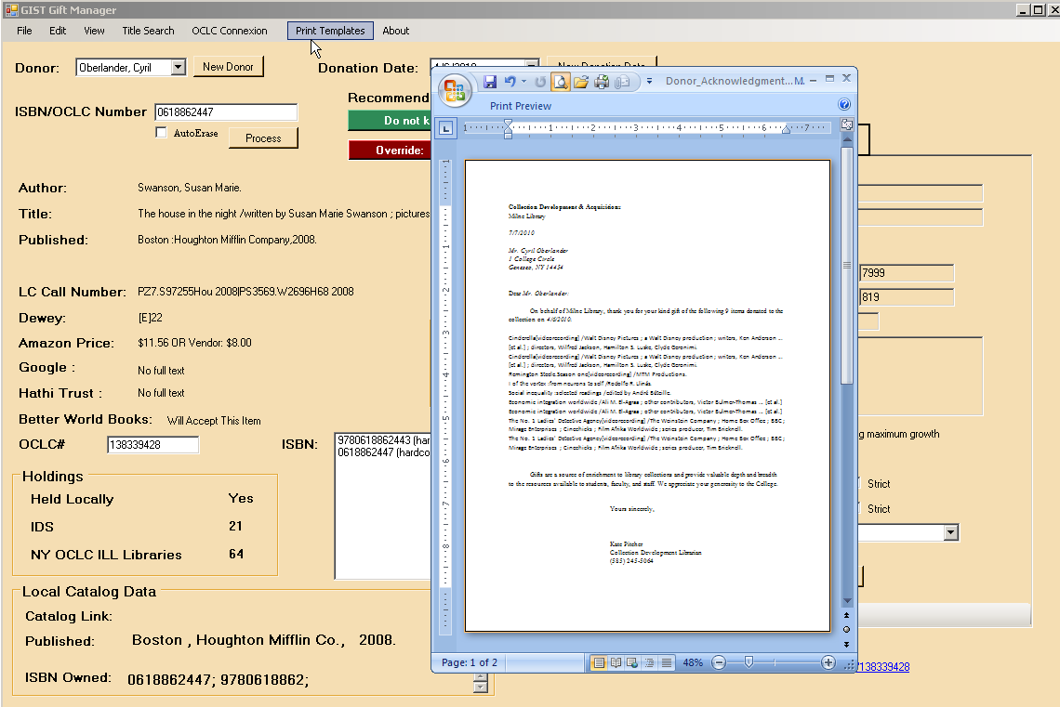
Thank You Letter

Slide 60
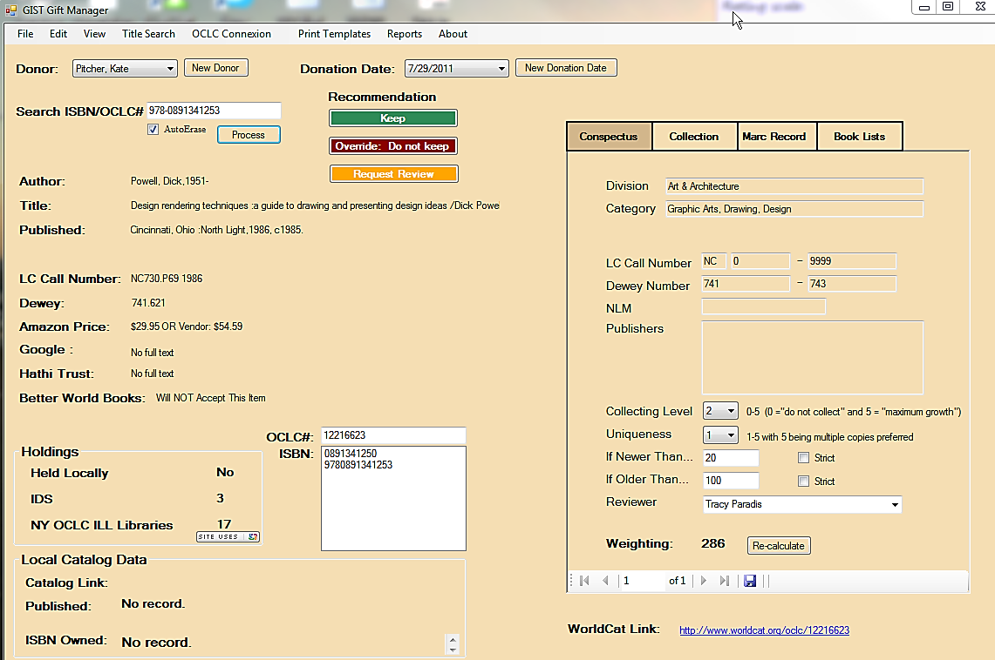
Activity B
Using the example below, do you agree with the GDM recommendation?
See Chapter 7 in workbook.

Slide 61
Questions?

Slide 62
Collection Management and Evaluation Using GDM
GIST Gift and Deselection Manager

Slide 63

GIST Deselection Manager: item by item
Notes:
When you change the GIST GDM to Deselection Manager, the interface looks much the same, although because you already own the item, the weighting is adjusted. Just wand in the ISBN, OCLC#, or look up by title, and voila, you have the recommendation, access to opening up OCLC Connexion and more.
Because this method of evaluating is item by item, and usually libraries can create lists of zero use from their library systems, GDM offers a batch analysis that provides useful evaluation information in spreadsheets.

Slide 64
Activity A
Activity A: Consider the following table of criteria; which ones matter when deselecting materials? Why?
Holdings | Collection Profile
Local & Format duplication | LC or Dewey areas in scope
Consortia (e.g. held by more than 3 libraries) | LC or Dewey areas out of scope
Region or State | Publication Dates (newer than, older than)
Full Text (e.g. held free full-text by Hathi) | Publisher
Other? | Other?
Other? | Other?
Notes:
Page 45 of workbook

Slide 65


GIST Deselection Manager: Batch Analysis
Batch Deselection
Import ISBN &/or OCLC# using an ILS report (e.g. 0 or low use report as a simple delimited file)
Run Batch Processing – GIST exports Excel file.
Review GDM data: Free full text, price, accepted by Better World Books, regional holdings, & more.
Sort by values, make decisions, then…
Batch remove from OCLC using Connexion
(or convert records for full-text holdings?)
  Possible Uses:
  Book and journal overlap analysis
  Identifying works to digitize
  Identifying materials for special collections
Notes:
What are other possible uses?
Just click Batch Deselection - Click on Open File - Locate your low or zero use report with OCLC#s or ISBNs; carriage return, not delimited (.txt file). Select variables; use strict dates to conspectus, ignore uniqueness, and/or extreme weeding. There are limits to the number of records that can be processed – Google Books API has 1,000 per day limit (if that criteria matters), Worldcat API depends on what you have asked for and received, they should be giving you 70K, which allows for about 23K items processed per day.
Click on Begin Batch Process and watch the numbers processing – when it is done, an Excel spreadsheet will open. Subject librarians and collection development can review report that includes the following data: Title, Author, Publication Date, OCLC Call Number (050 or 090 field), # holdings in your groups, Full Text in Hathi Trust and Google Books, Better World Books Library discard acceptance, Conspectus recommendation
GDM batch analysis has been used for JSTOR analysis, and can be used to identify items to move from open stacks to special collections, or which works haven’t been digitized yet.

Slide 66
Extreme Weeding 2010
13 % of titles in storage are available FULL-TEXT through Hathi Trust digital repository
Notes:
At Geneseo, GDM helped us weed a large unused collection in a storage facility, the number of full-text from Hathi Trust surprised us, but did have us questioning whether we should create a derivative record full-text from our print record – we decided that since GIST for ILLiad automatically checks Google Books and Hathi Trust, we no longer needed the record in our catalog for items that we removed the print and full-text is available.

Slide 67

Activity B:
Analyze GDM Deselection Report
See Chapter 8 in workbook.
Notes:
Page 46 of workbook:
Would you weed…
The poetical works of Henry Kendall / edited by T. T. Reed
Hypatia; or, New foes with an old face. By Charles Kingsley
Poems /by Charles Kingsley
Why or why not?

Slide 68
Duplication & Extreme Weeding 2011
1 Library
2 Libraries
Holdings found in IDS Project libraries
3 Libraries
4 + IDS Libraries hold these titles
Notes:
Weeding 0 use titles for our summer project; 199, 579 items in Zero Use report between 1/1/2005 and 11/1/2010;
Full-text availablity:
Google Books = 3% of this 199, 579 items are available
HathiTrust (digital repository of materials held by several major research libraries, including Harvard and the University of Michigan → holds 2,066,886 volumes (~25% of total) in the public domain ) = 4% of our 0 use titles are found in HathiTrust
Goal is to weed at least 10% of this collection this spring and summer
Sheila & Joan leads on this project
Goals:
Weed old, outdated, irrelevant and little-used materials.
Diversify the collection – weed materials that are duplicated across NYS.
Provide growth area for collections that we will still be acquiring monographs and foresee an increase in the near future (History, etc.)

Slide 69
Questions?
See Chapter 8 in workbook.

Slide 70
Planning for your library’s transformation
GIST Transformation Manager

Slide 71

GIST Planning
Gathering Data
Decisions
Alternate Process
See Chapter 9 in workbook.

Slide 72
GIST Acquisitions Manager Overview: assembling the pieces…
GIST Toolkit
Service Delivery

Slide 73

GIST
Planning

Slide 74

GIST Planning
How easy is this question?
How easy is it to miss someone that should be here?

Slide 75

GIST Planning
Streamline purchase on demand workflow
Pass requests easily between ILL & Acquisitions
People are willing to change their processing
ILL and Library IT will help implement GIST for Acquisitions
See Chapter 9 in workbook.

Slide 76

GIST Planning

Slide 77

GIST
Planning
Gathering data, reading the literature, and preparing a plan are critical to success.

Slide 78
Planning for change
What works?
Let data – especially user data - help lead your way.
Learn from failure but don’t stop trying.
Don’t assume that because you got no last year that means not trying again – the game is changing every day.
Share and support others; what are your success stories with purchase on demand?
Other ideas?

Slide 79



Organization is our specialty…

Slide 80
GIST Planning
Questions?

Slide 81

Thank you for Participating in the GIST Institute
Getting It System Toolkit – GIST Team
Kate Pitcher Cyril Oberlander Tim Bowersox Mark Sullivan

